Slide 1
DISCLAIMER: ASTC has not purchased the rights to use the images in this presentation for commercial purpose. So, we encourage to present it ‘on-screen’, but please do not share/transmit this presentation outside of your educational session.

Slide 2
WHAT IS A THEATRE CONSULTANT?
YOURS TRULY.

Slide 3
What does a theatre consultant do?

Slide 4
What does a theatre consultant do?

Slide 5
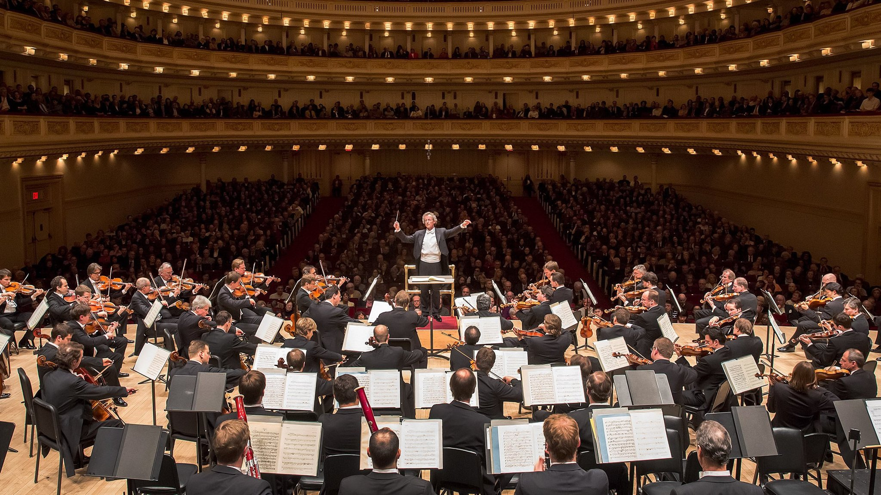
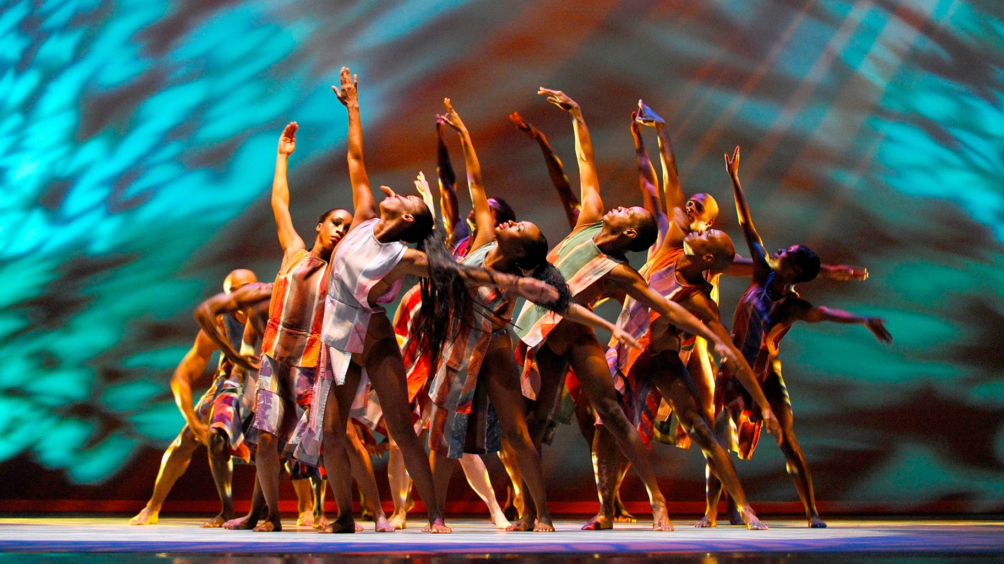
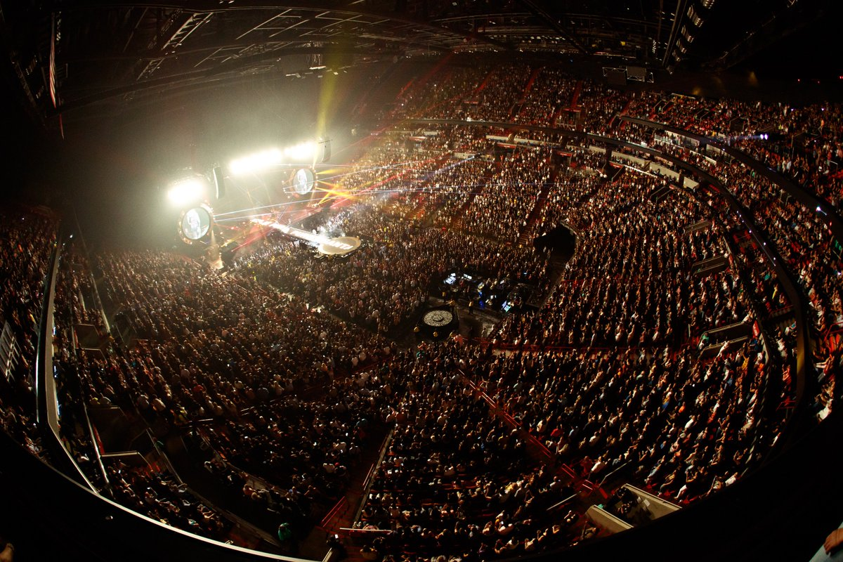
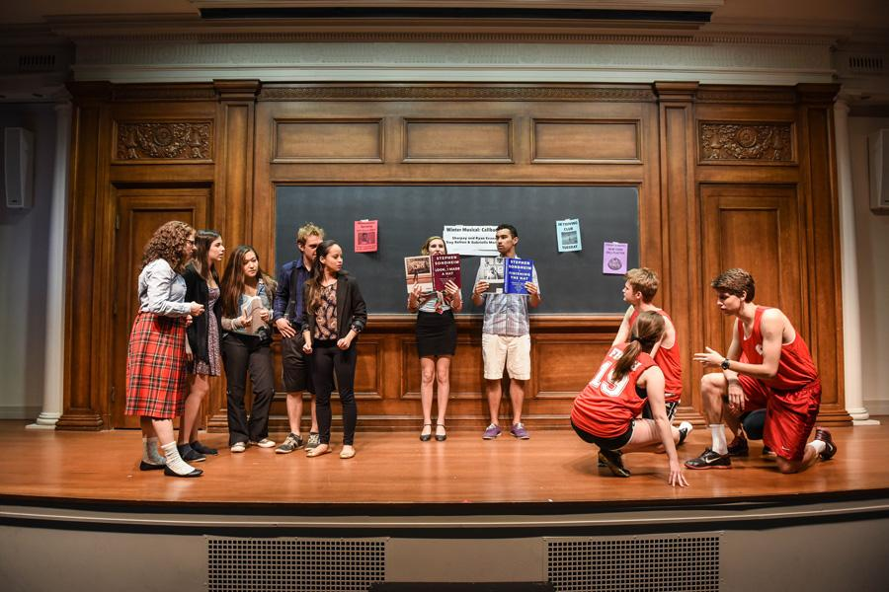
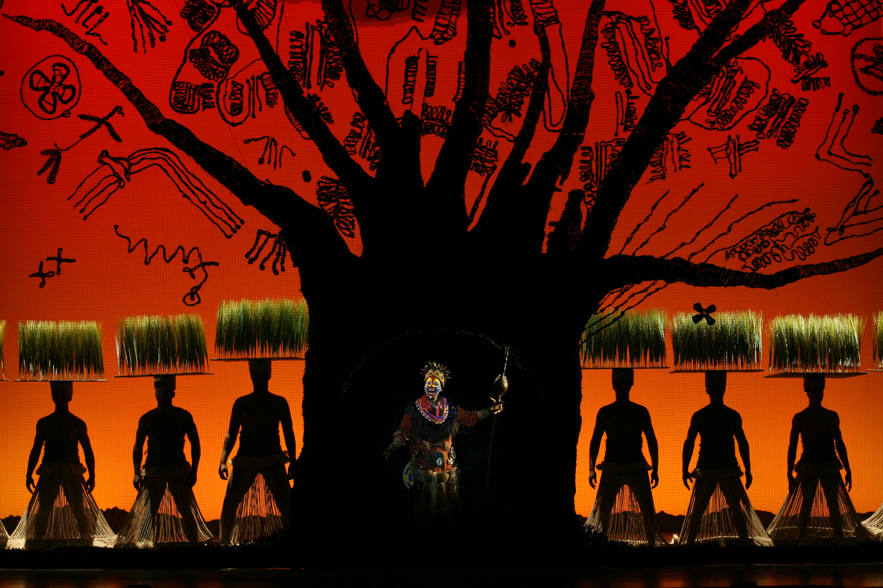
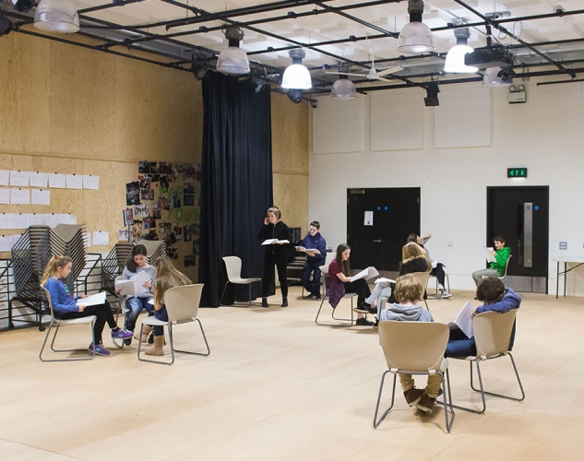
theatre (& performing arts & gathering…)

Slide 6
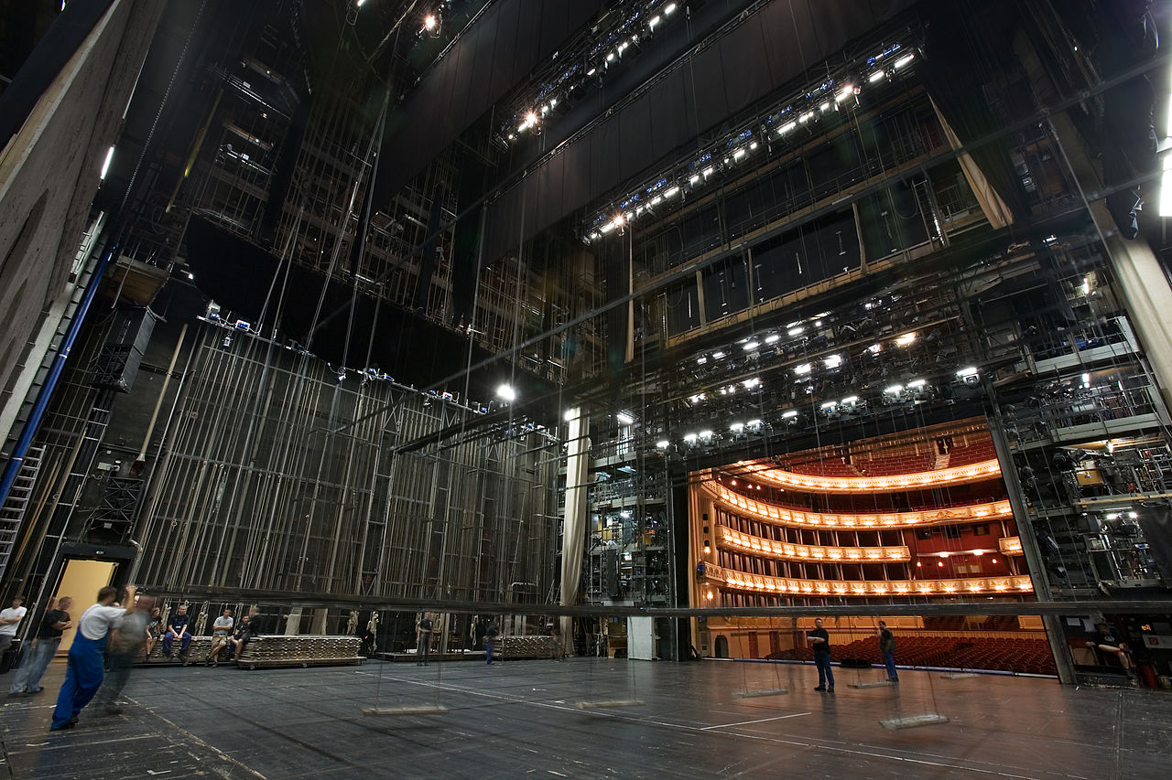
but there’s more behind the scenes…

Slide 7
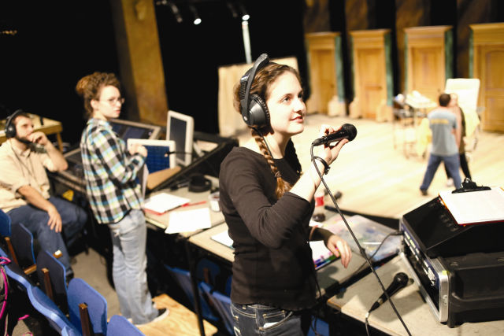

Slide 8
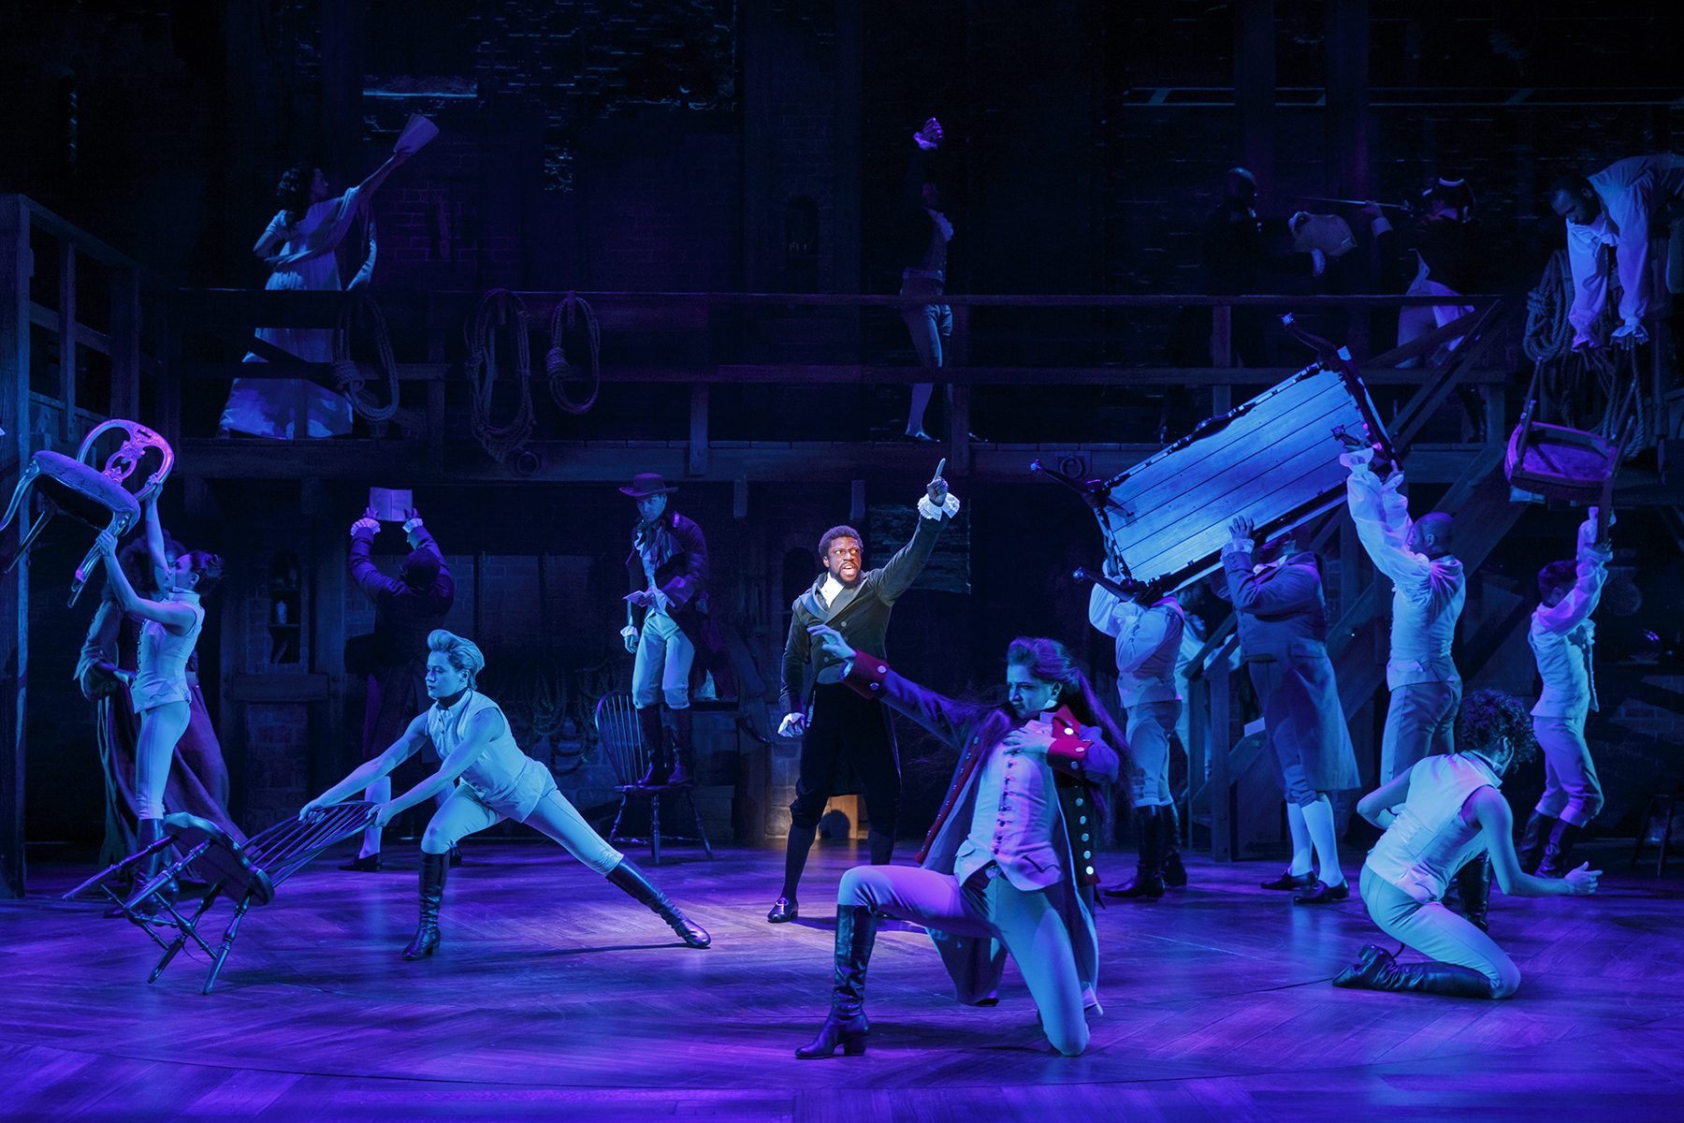
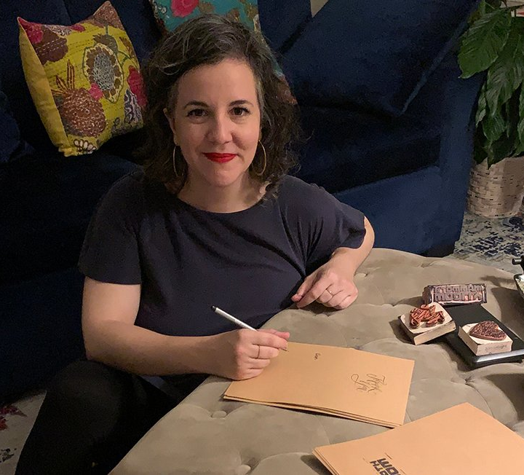

Slide 9
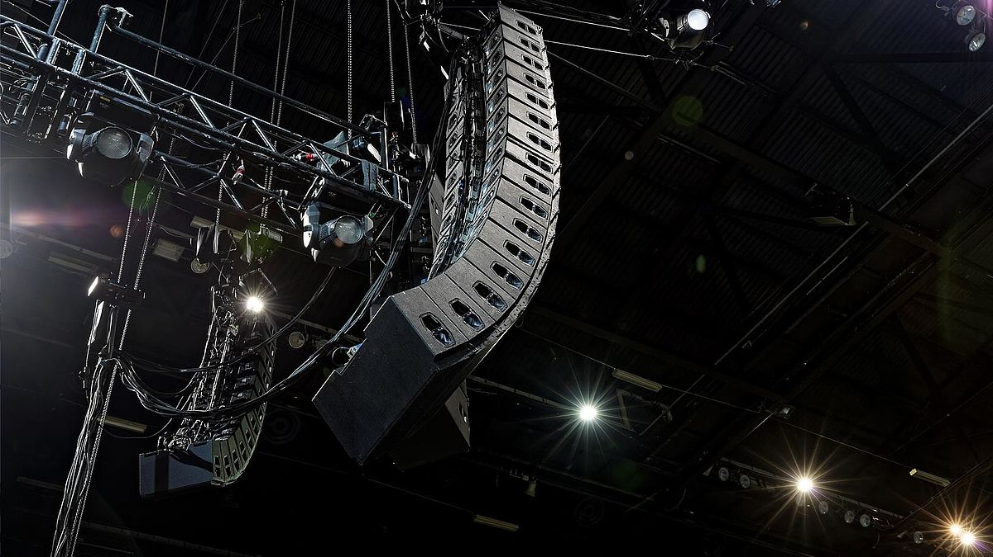
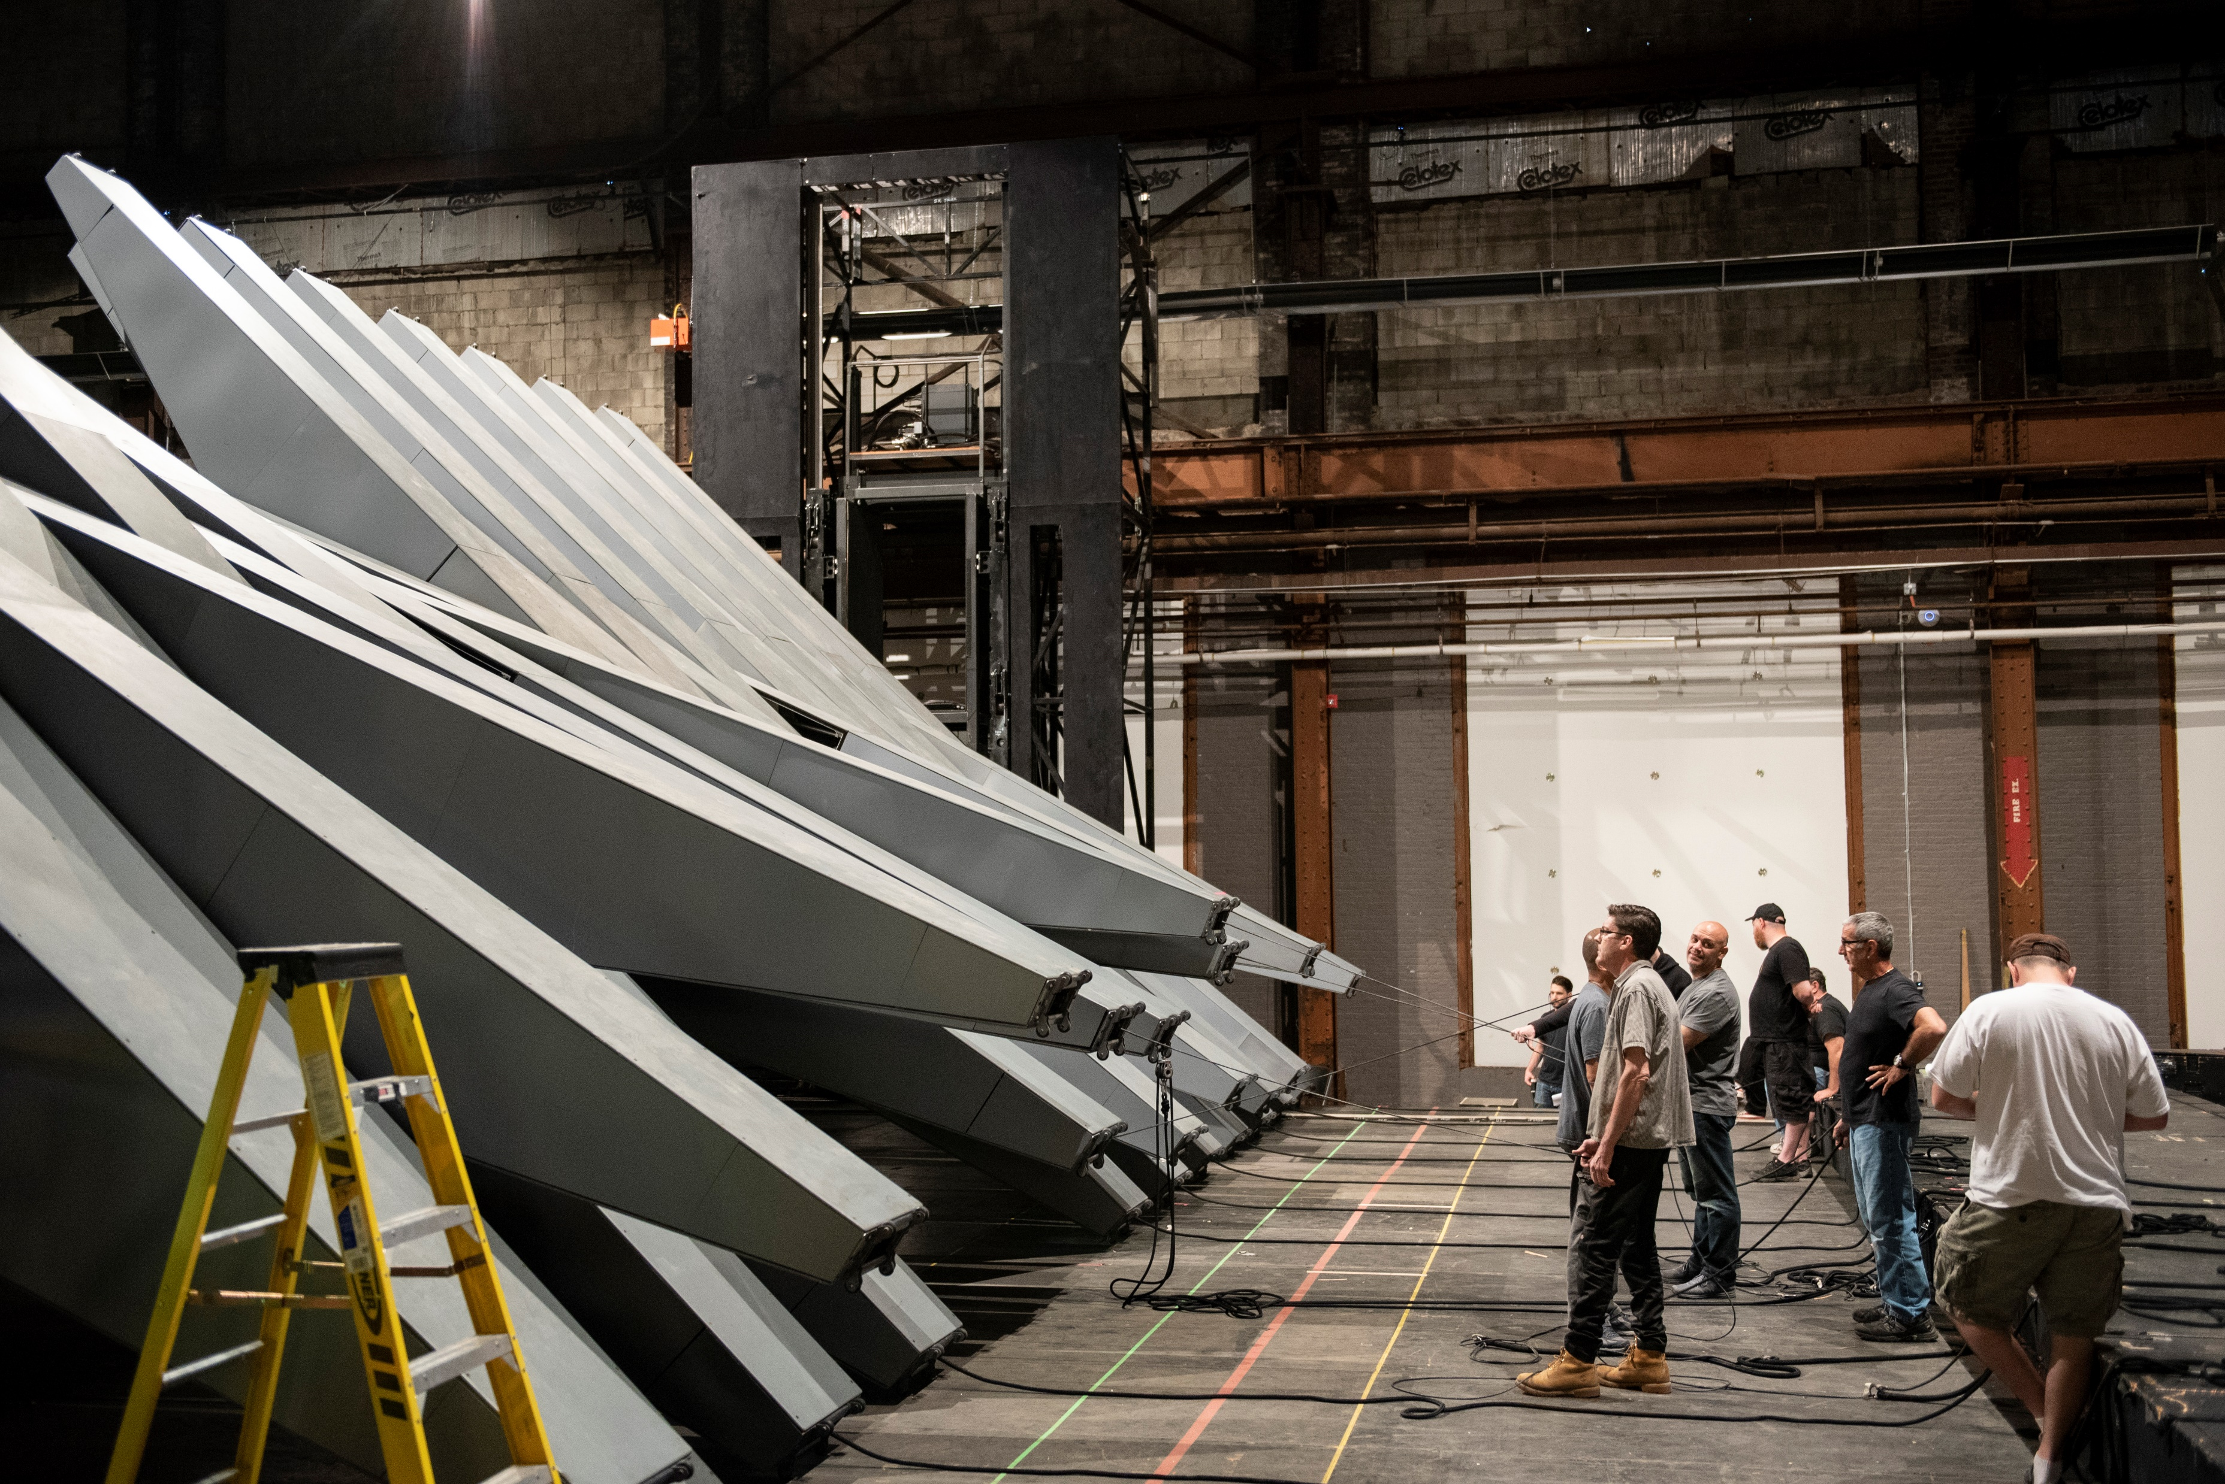

Slide 10
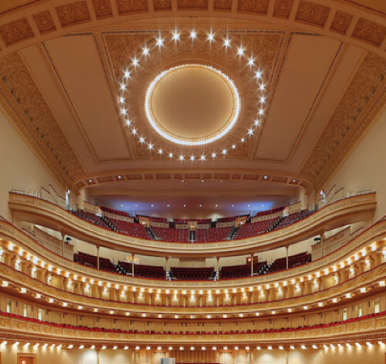
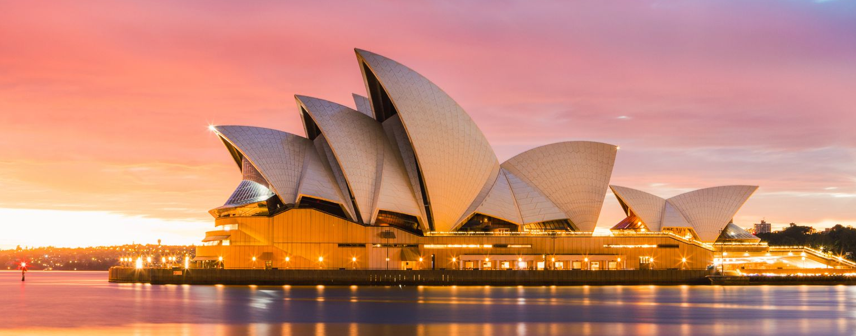
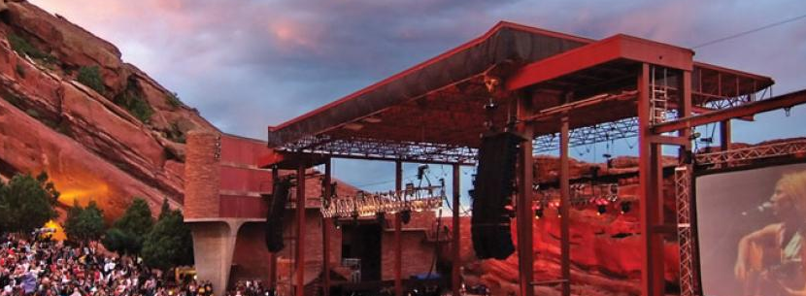
there is also another player…

Slide 11
Theatres Concert halls
Opera houses Stadia
Houses of worship
Meeting rooms Arenas
Schools Amphitheatres
Other venues

Slide 12
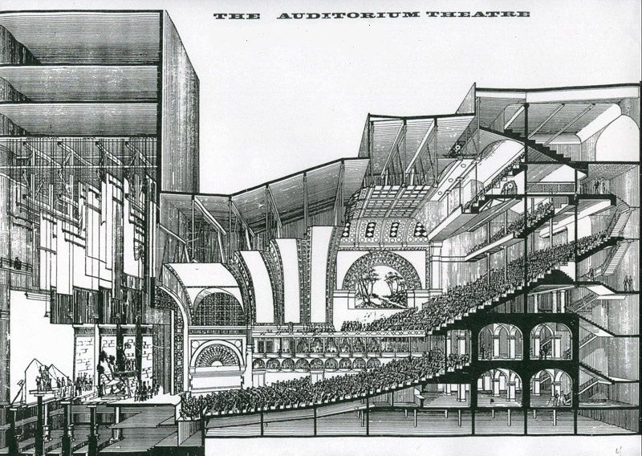
theatre consultants design theatre buildings

Slide 13
But how do theatre buildings get built?

Slide 14
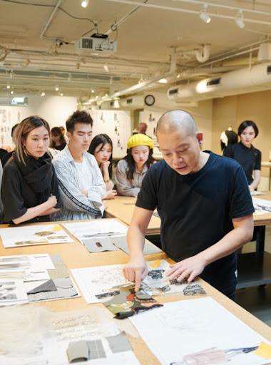

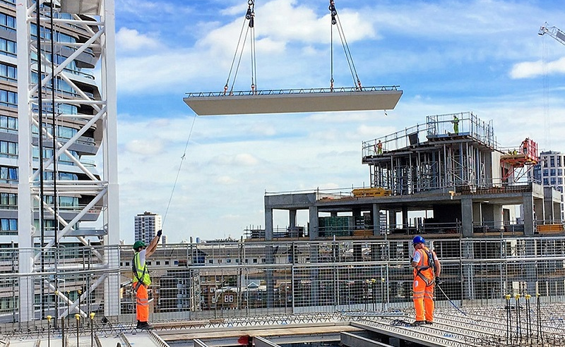

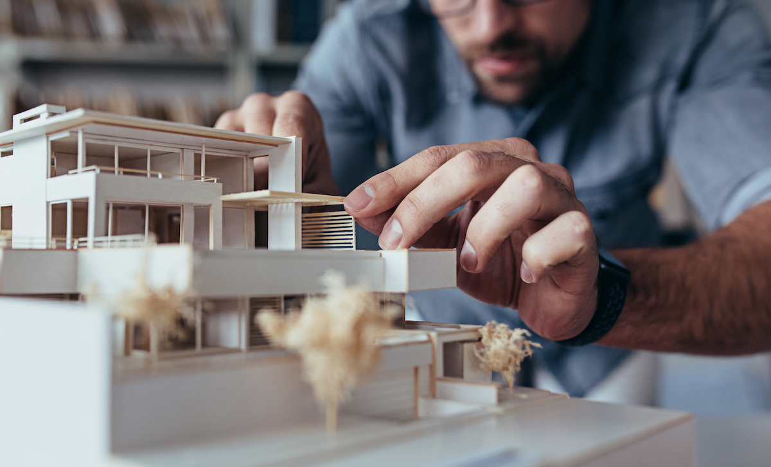
BUILD
VISION
DESIGN
PERFORM!

Slide 15
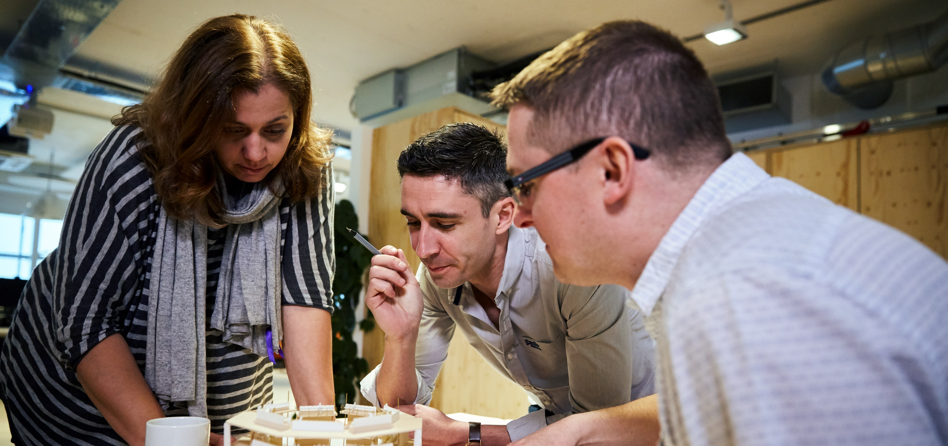
theatre consultants design theatre buildings

Slide 16
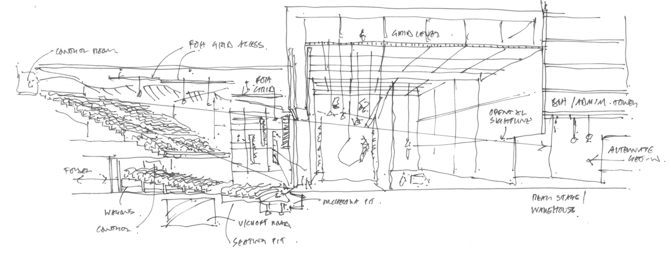
theatre consultants design theatre buildings

Slide 17
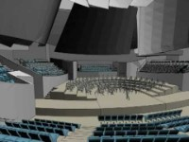
theatre consultants design theatre buildings

Slide 18
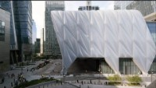
theatre consultants design theatre buildings

Slide 19
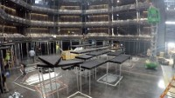
theatre consultants design theatre buildings

Slide 20
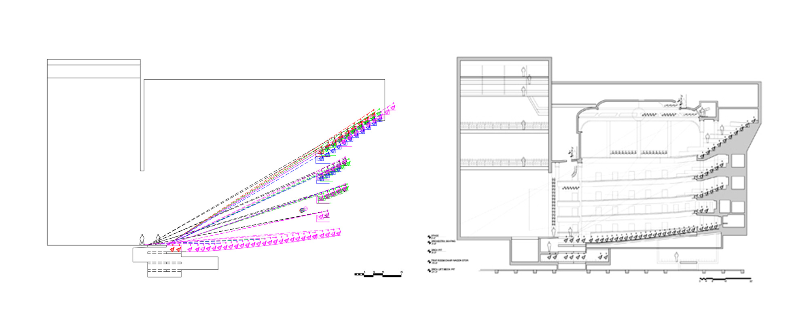
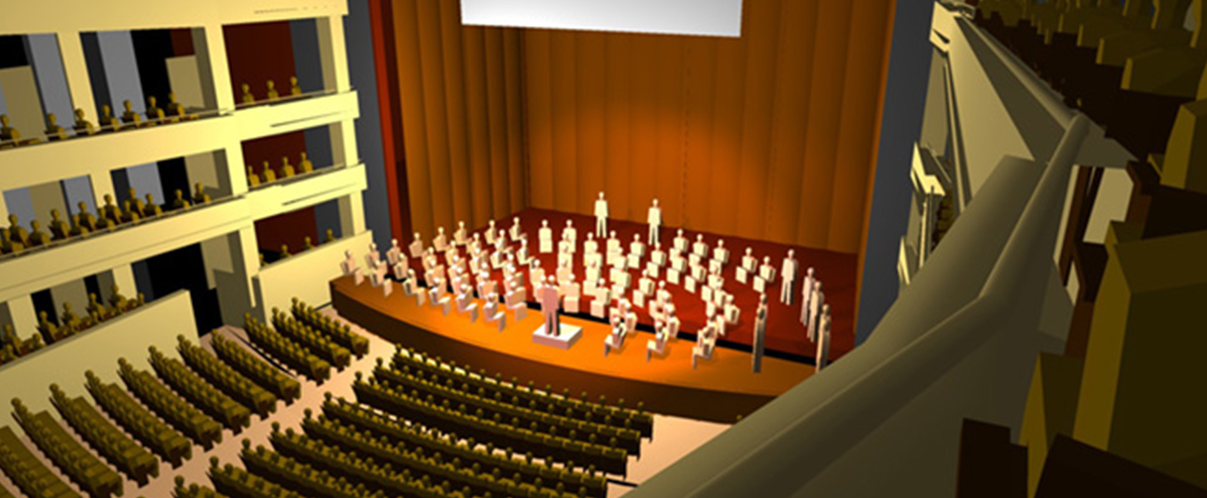
theatre consultants design theatre buildings

Slide 21
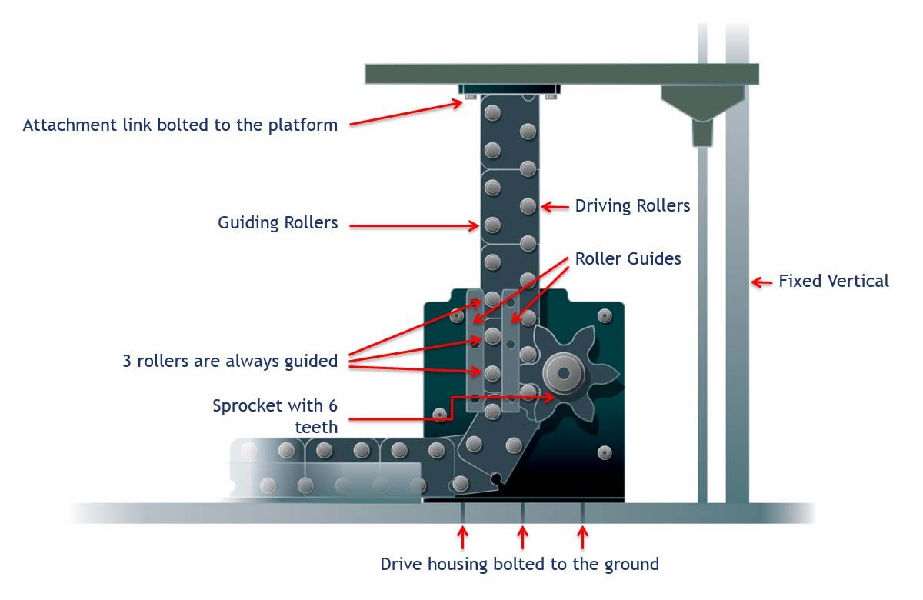
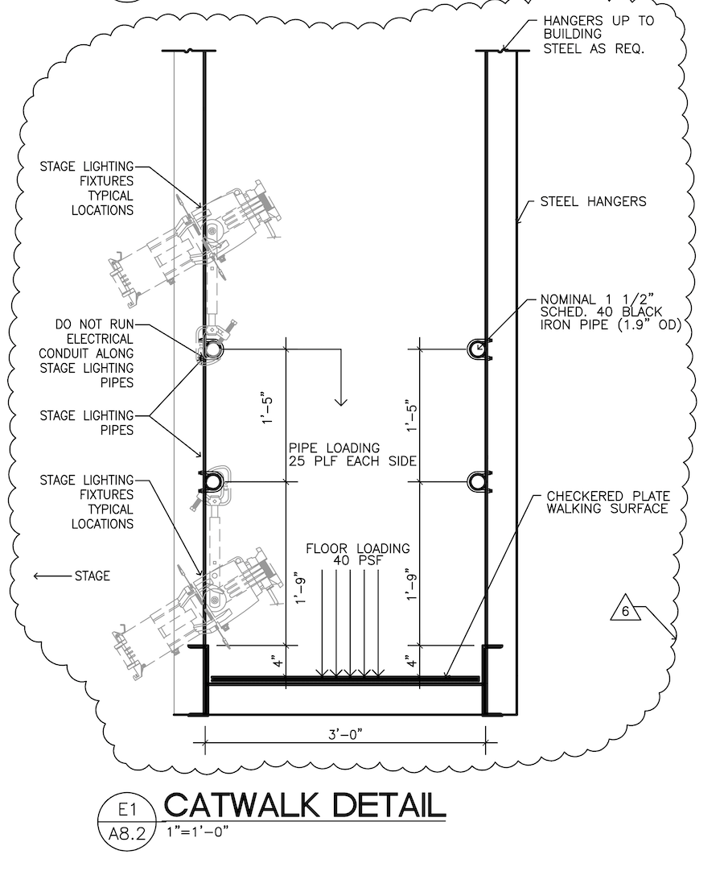
theatre consultants design theatre buildings

Slide 22
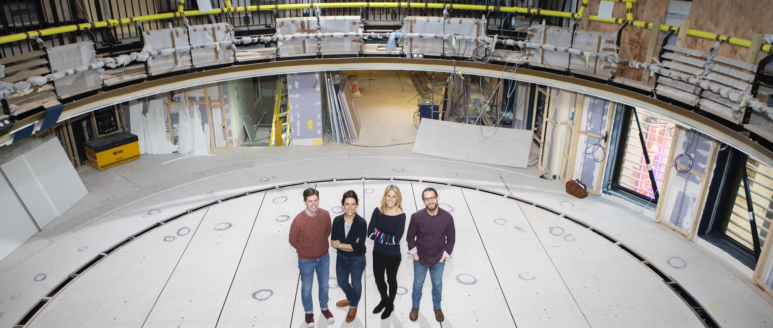
theatre consultants design theatre buildings

Slide 23
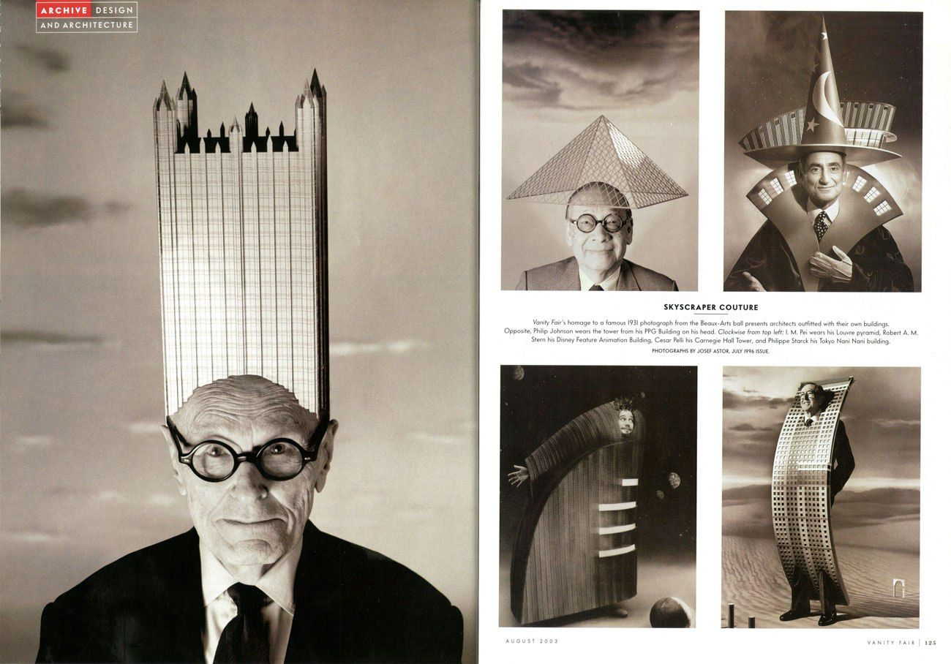
but what about architects?

Slide 24
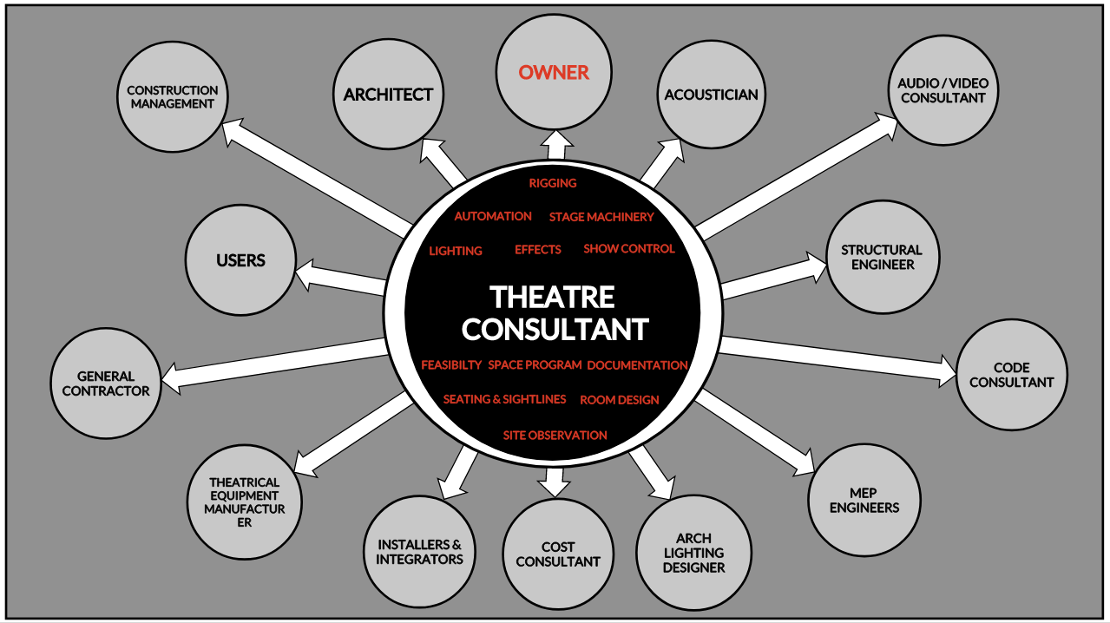

Slide 25
where do theatre consultants come from?

Slide 27
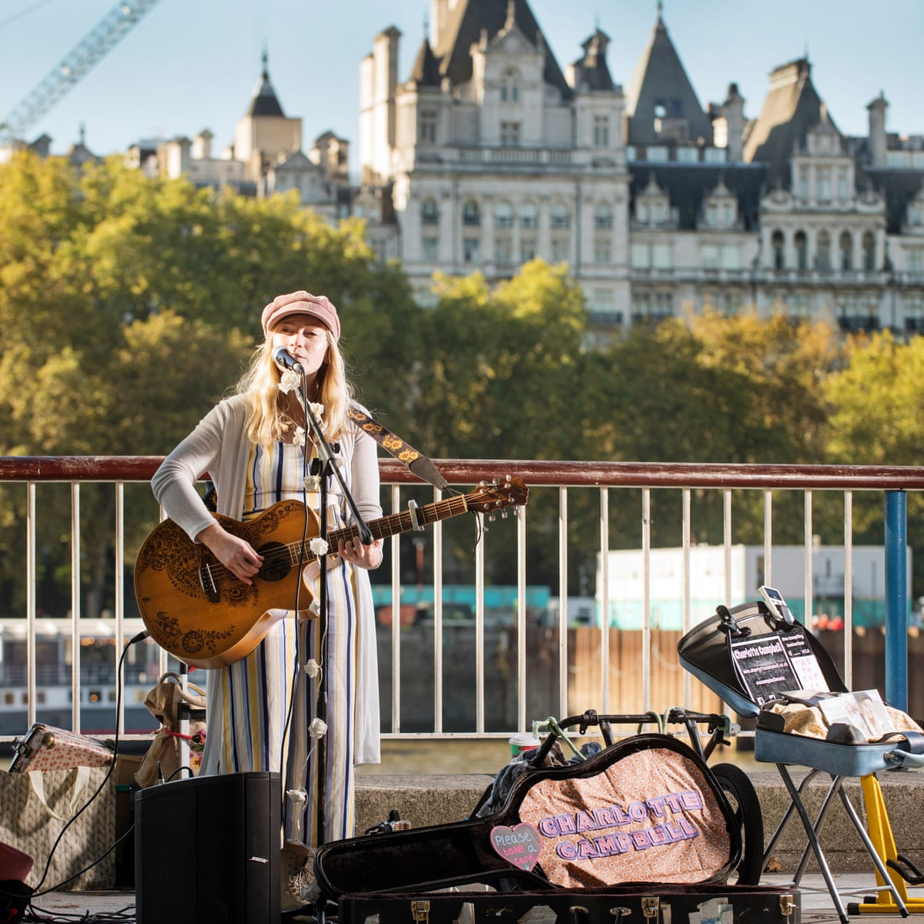
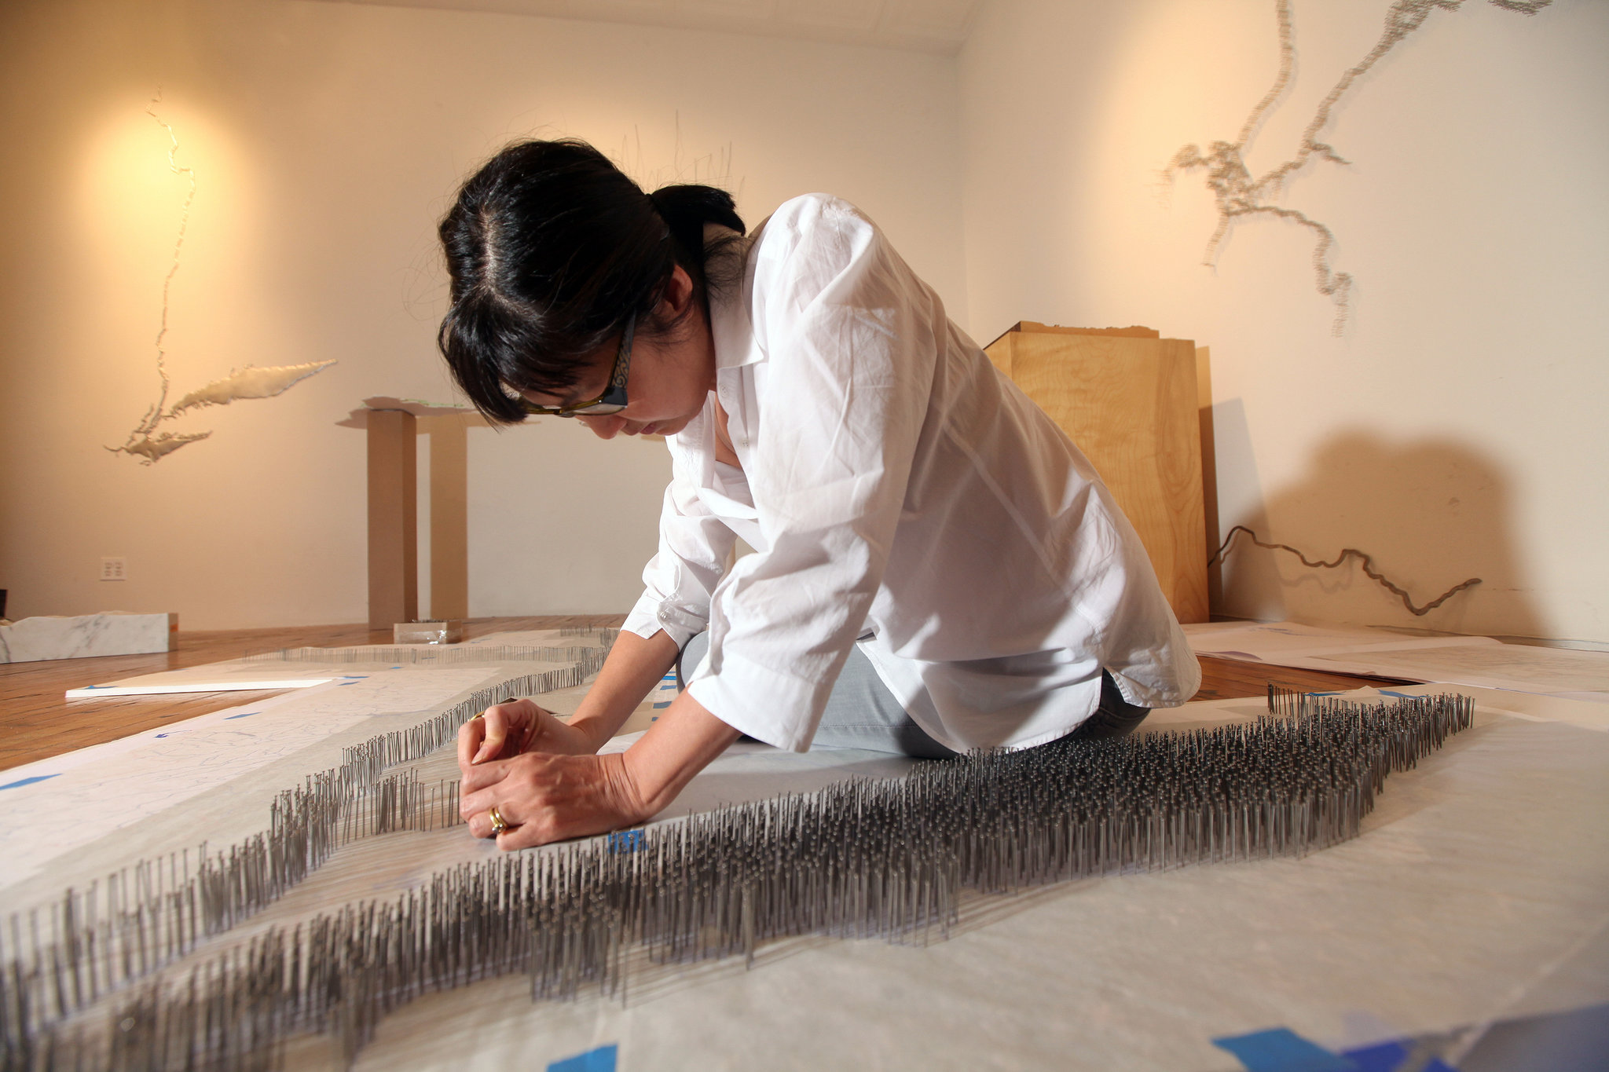

where do theatre consultants come from?

Slide 28
where do theatre consultants come from?
(Personal stories, your own, and from the survey)

Slide 29

What is the
AMERICAN SOCIETY OF THEATRE CONSULTANTS?

Slide 30
ABOUT ASTC
The American Society of Theatre Consultants (ASTC) was founded on the premise of creating a forum for collaboration and a vehicle for sharing members’ knowledge and experiences of design and technologies for the performing arts, entertainment and theatre industries.
An organization where theatre consultants from all around North America can contribute new and traditional ideas with the goal of developing assembly environments for future generations. It is a structure for bringing topical issues to the forefront with policymaking by those that know the business. It is an association with respect and a voice that would be heard in making it a better and safer industry. By developing this alliance based upon shared interests and goals, ASTC plays an active role in fostering awareness, interpretation, understanding, education, and appreciation within the industry.
The ASTC members are experienced in new, restoration and presentation projects including:

Slide 31
How can WE help?

Slide 32
Going to plays, concerts, events.
Making plays.
Acting.
Playing music.
Tinkering.
Observing.

Slide 33
www.theatreconsultants.org
www.noma.org
(put links to local arts/design organizations here)

